Slide 1

Sprint 1 Presentation

Slide 2
What we’ve done so far
Database
Web Service
Android App
Desktop Website

Slide 3
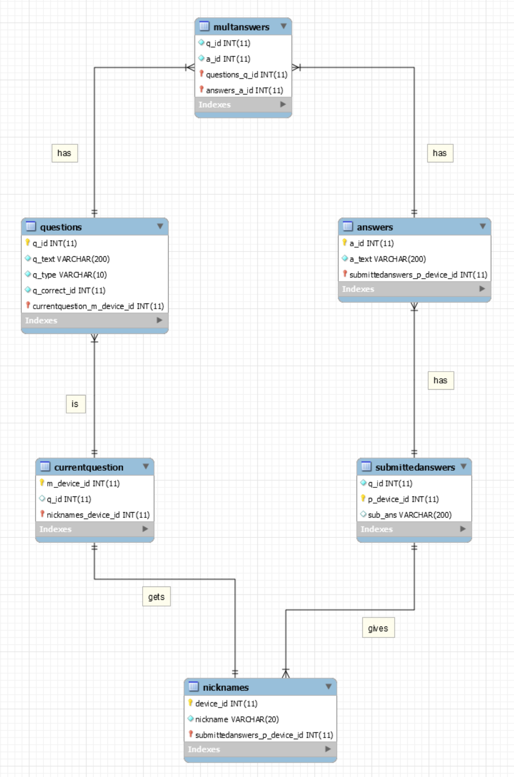
Database

Slide 4
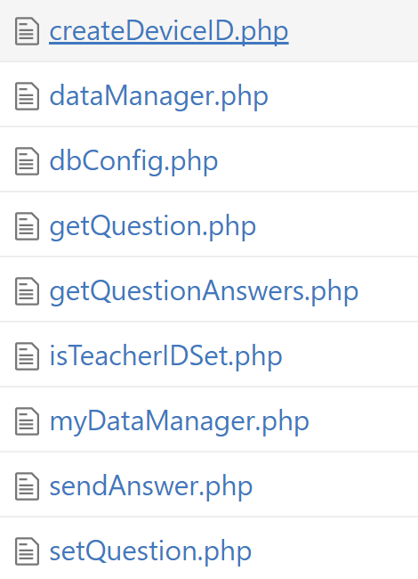
Web Service

Slide 5
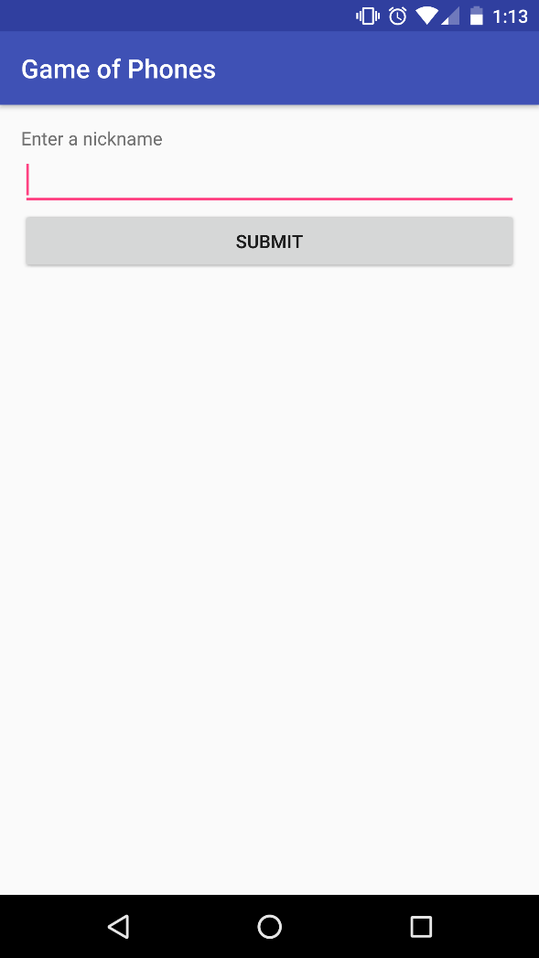
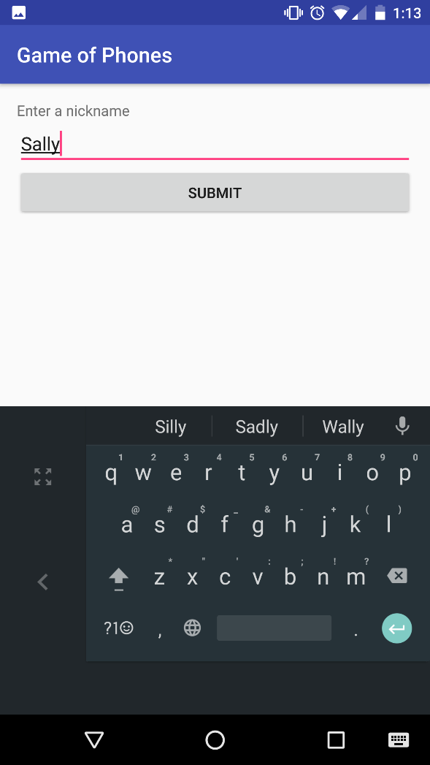
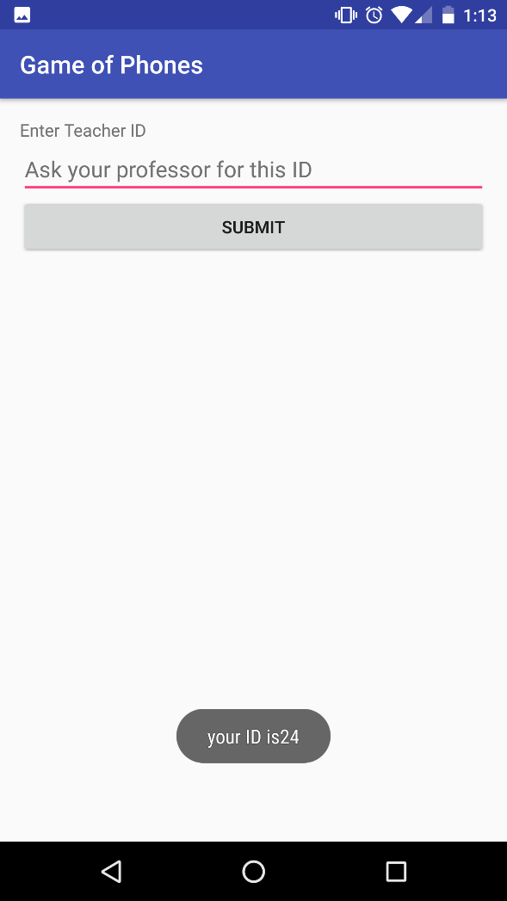
Android App

Slide 6
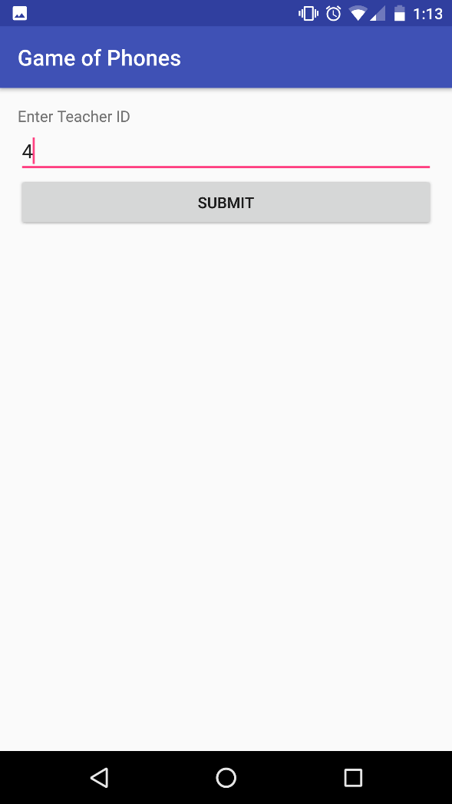
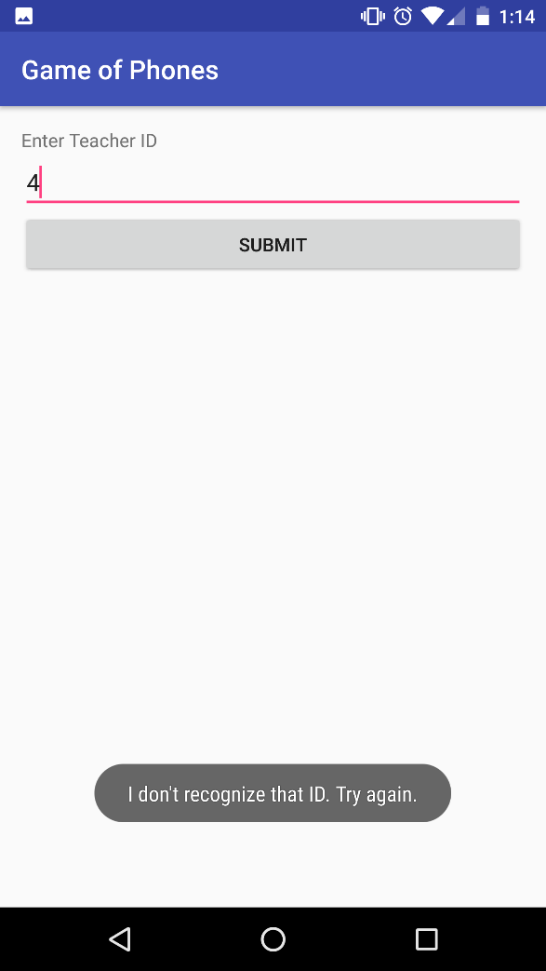
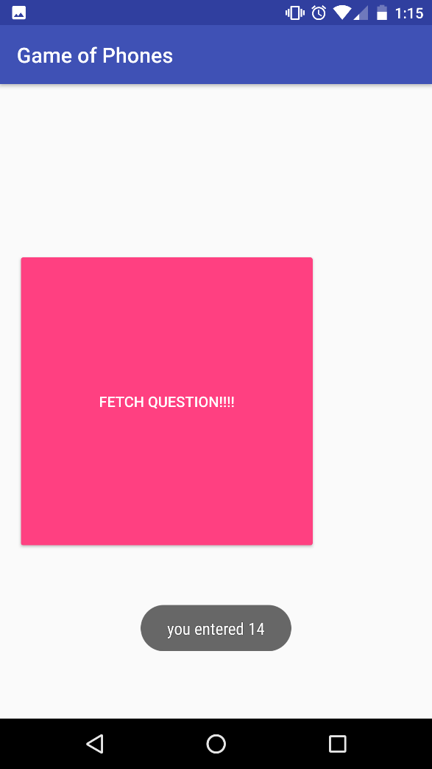
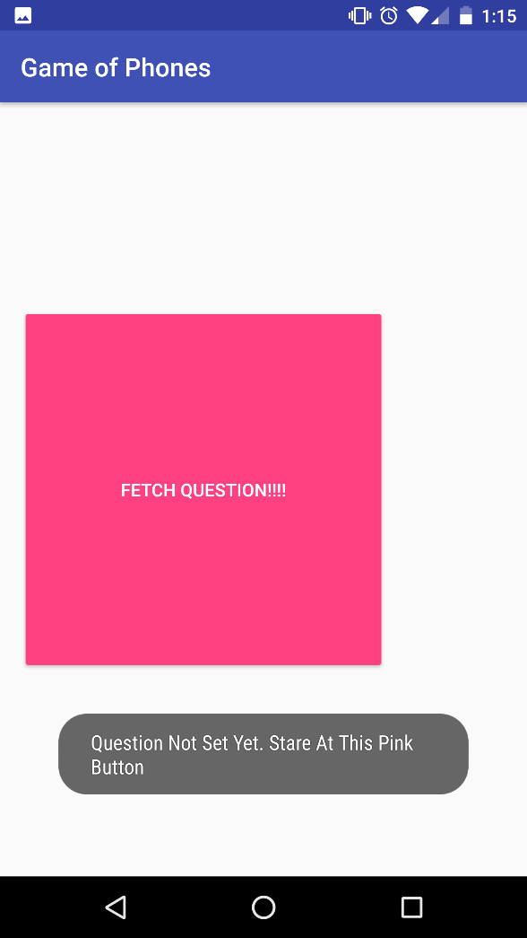

Slide 7
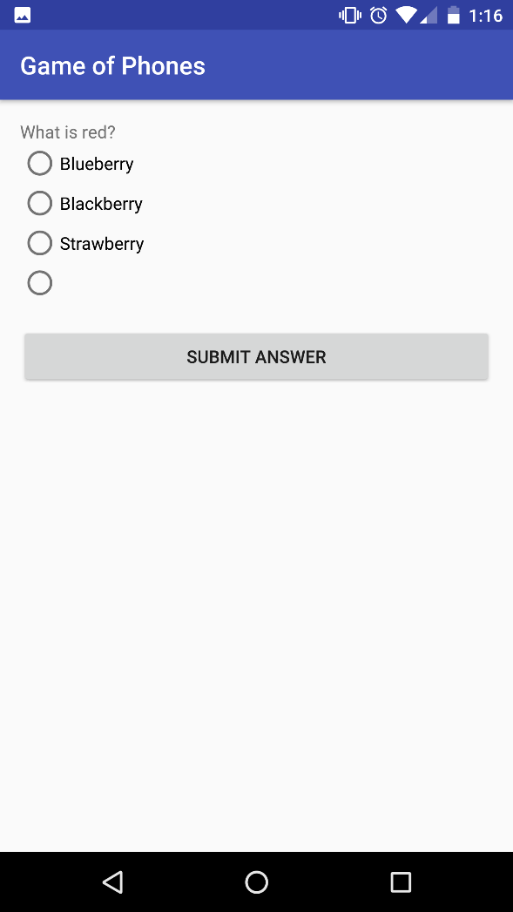
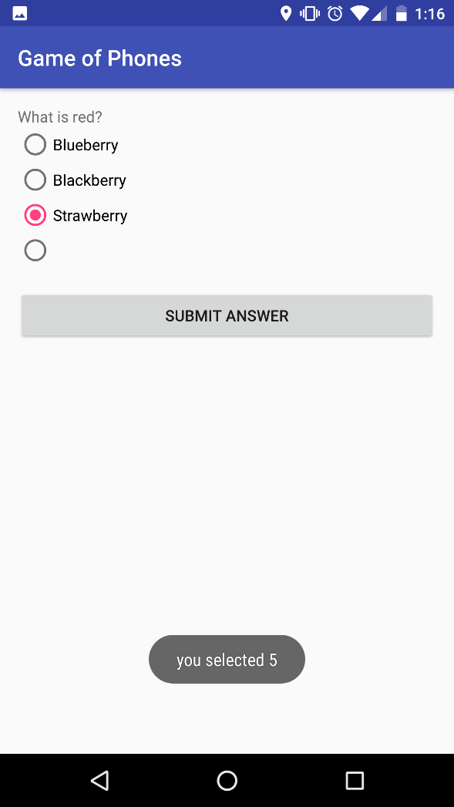
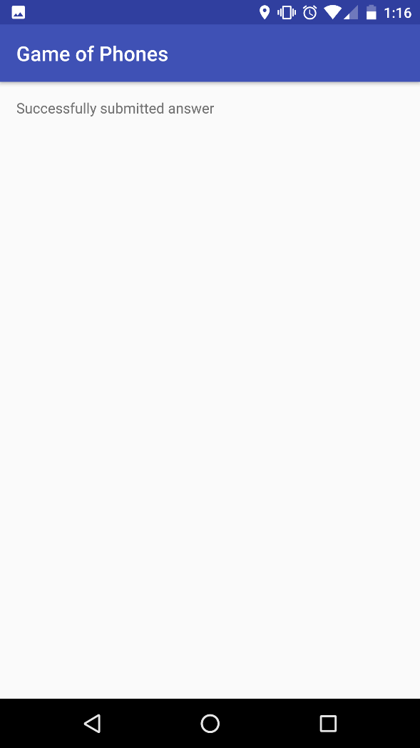

Slide 8
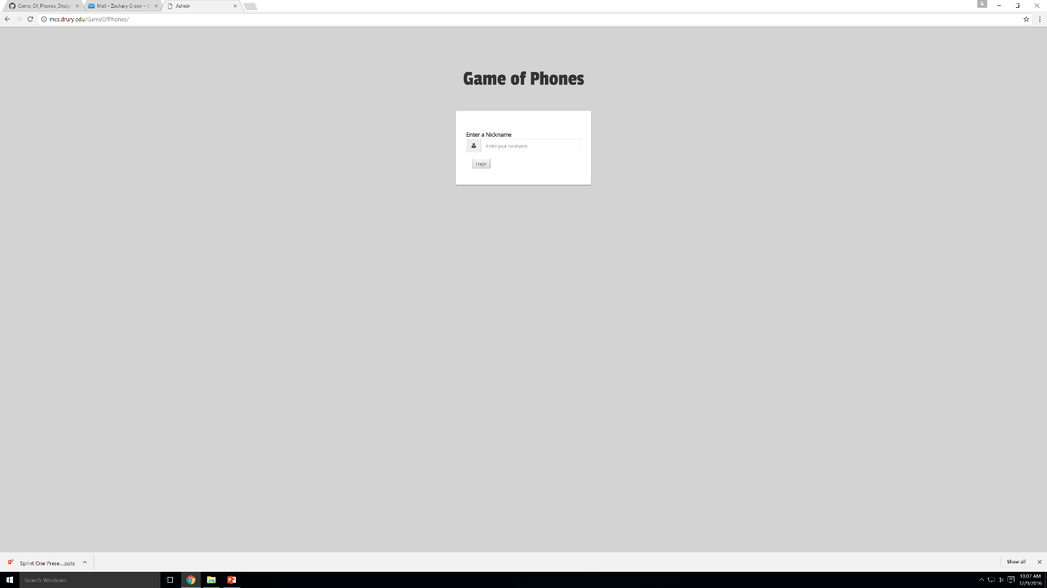
Desktop Website

Slide 9
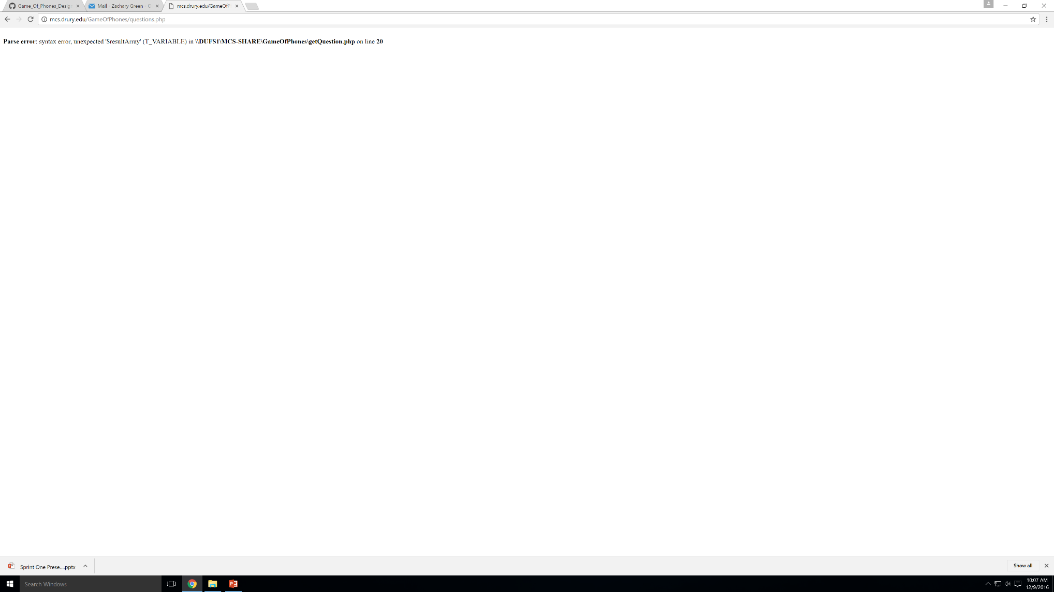

Slide 10
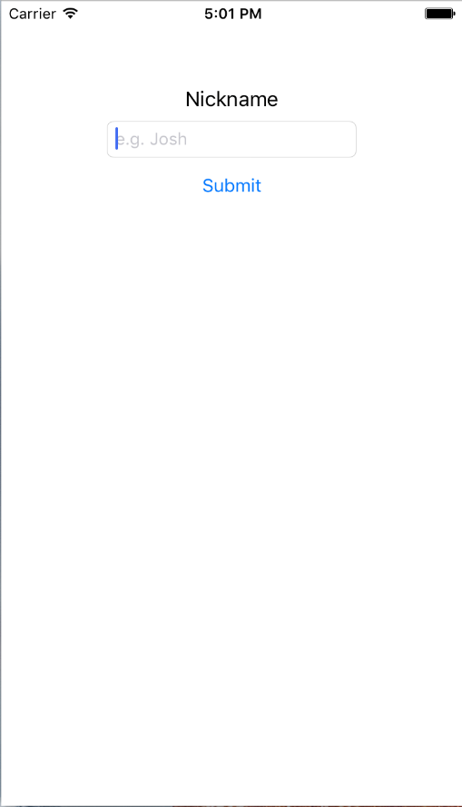
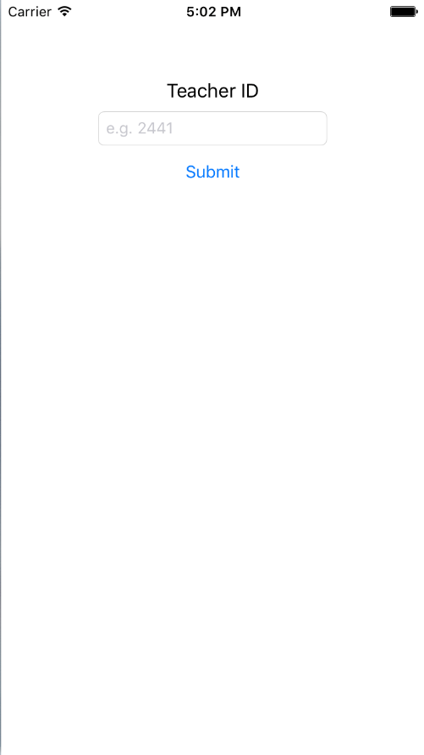
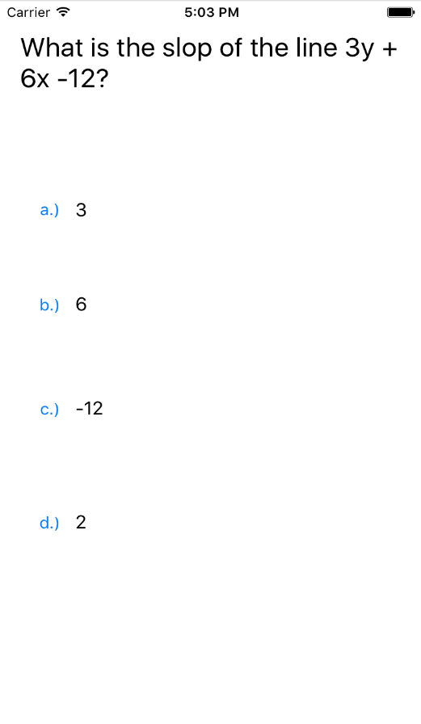
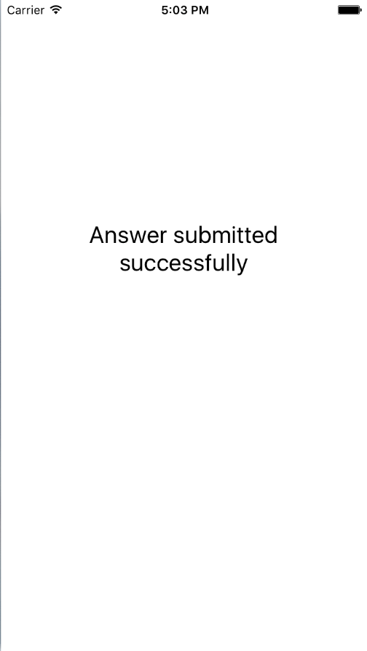
Apple App

Slide 11
Acceptance?
Ask Questions
See all the Q's from the database
Pick a Q
Some confirmation that it was successfully submitted
Answer Questions
Can enter a nickname
Get the current question
Input an answer
Some confirmation that it was successfully submitted

Slide 12
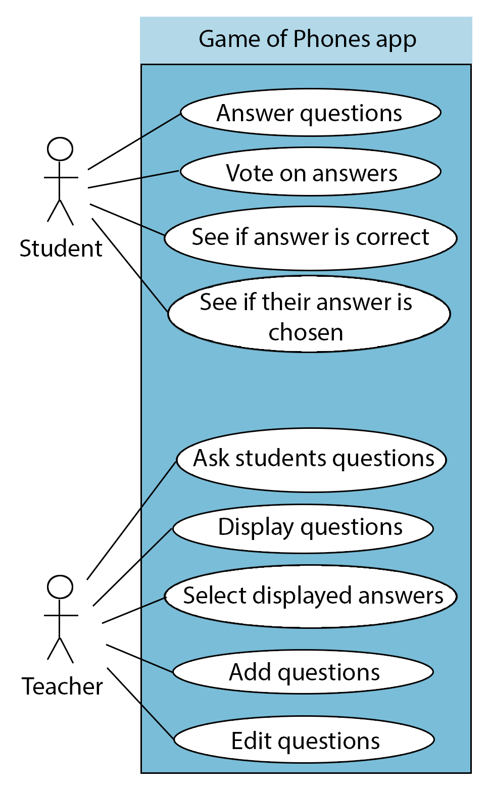
What we’re doing later
Sprint 2:
Display Questions
Select Displayed Answers
See if answer is chosen
Ask questions with images
Sprint 3:
Vote on answers
See if answer is correct
Add and edit questions
Work on graph functionality
Functions to clear unneeded data from the database

Slide 13
Current issues to fix
Validating inputs on the android app; Nicknames, teacher IDs
Expand code for more general cases
Expand database for more functionality
Organize code for readability

